Slide 1
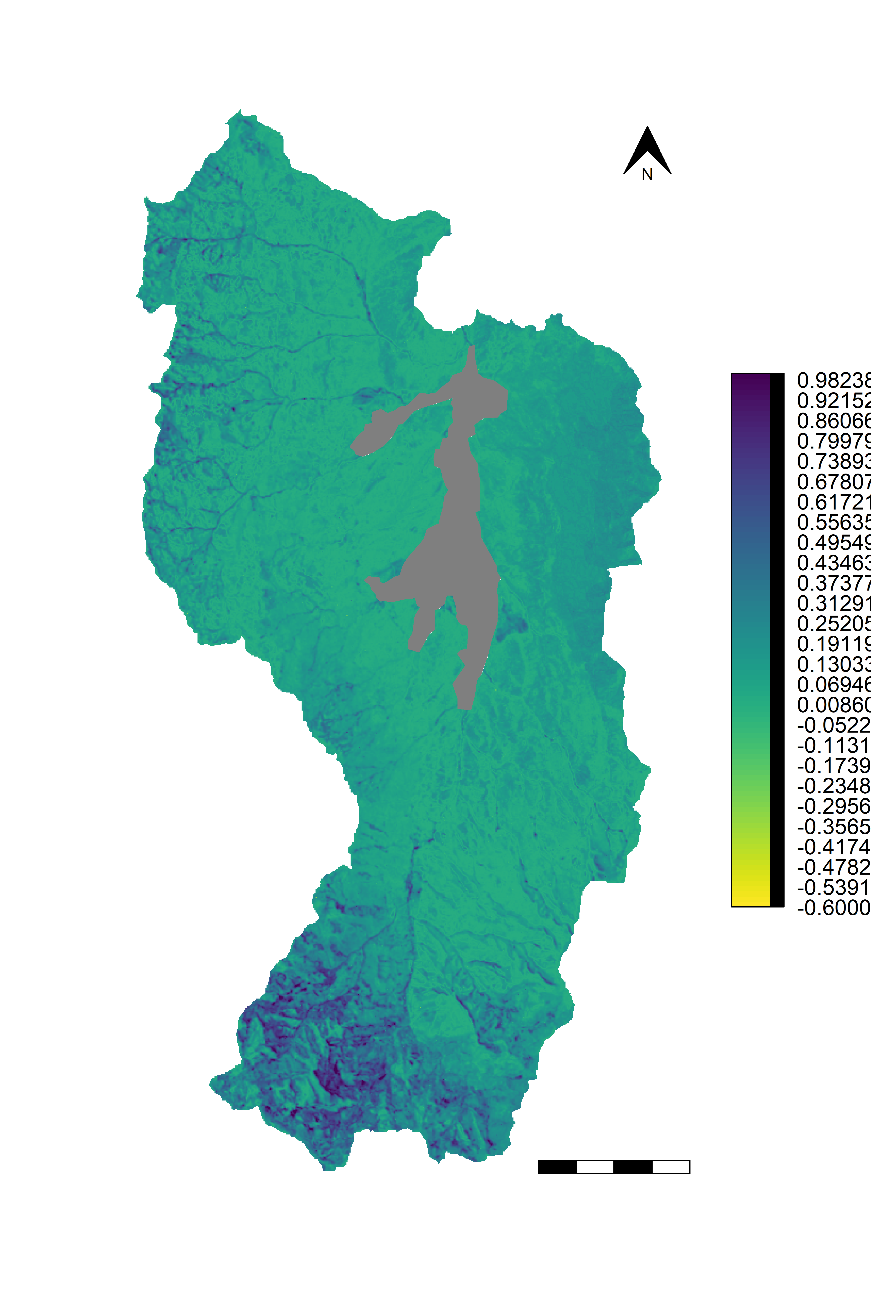
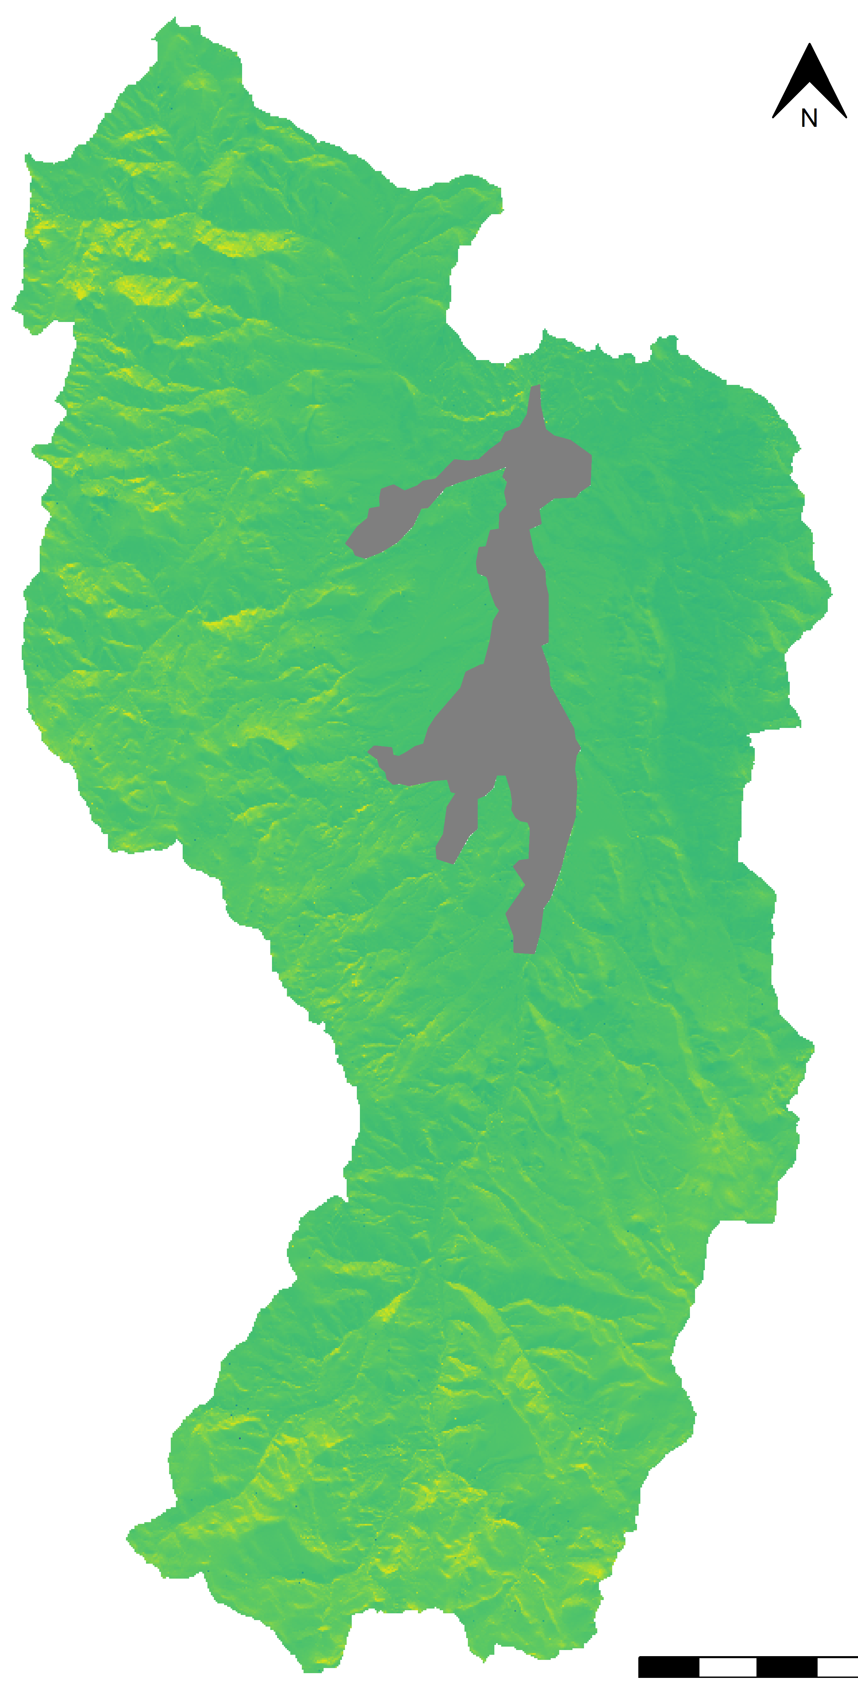
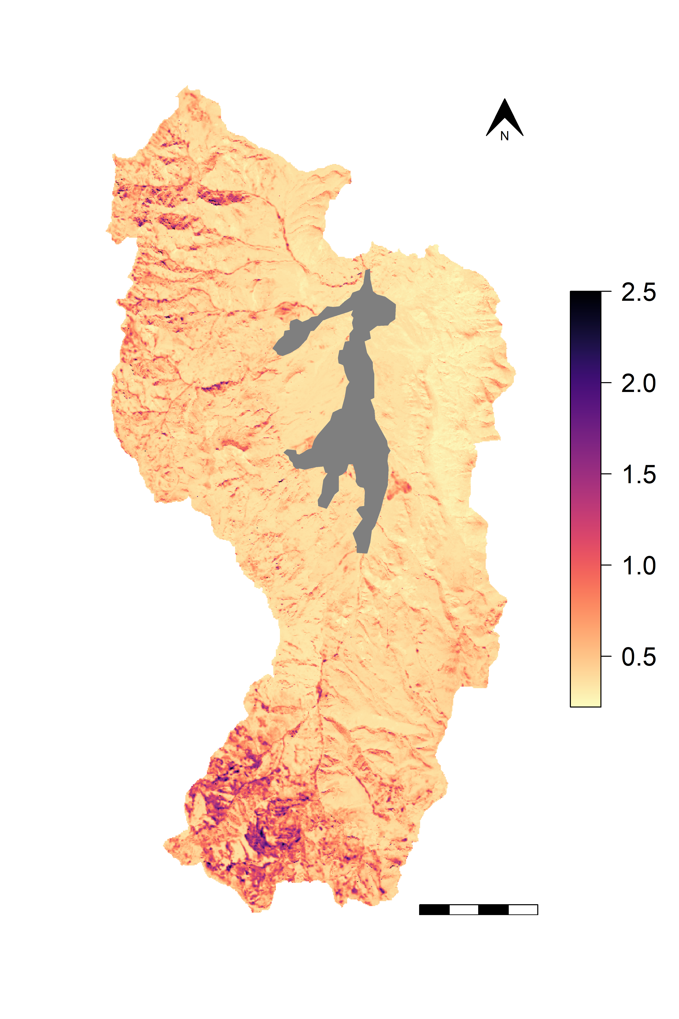
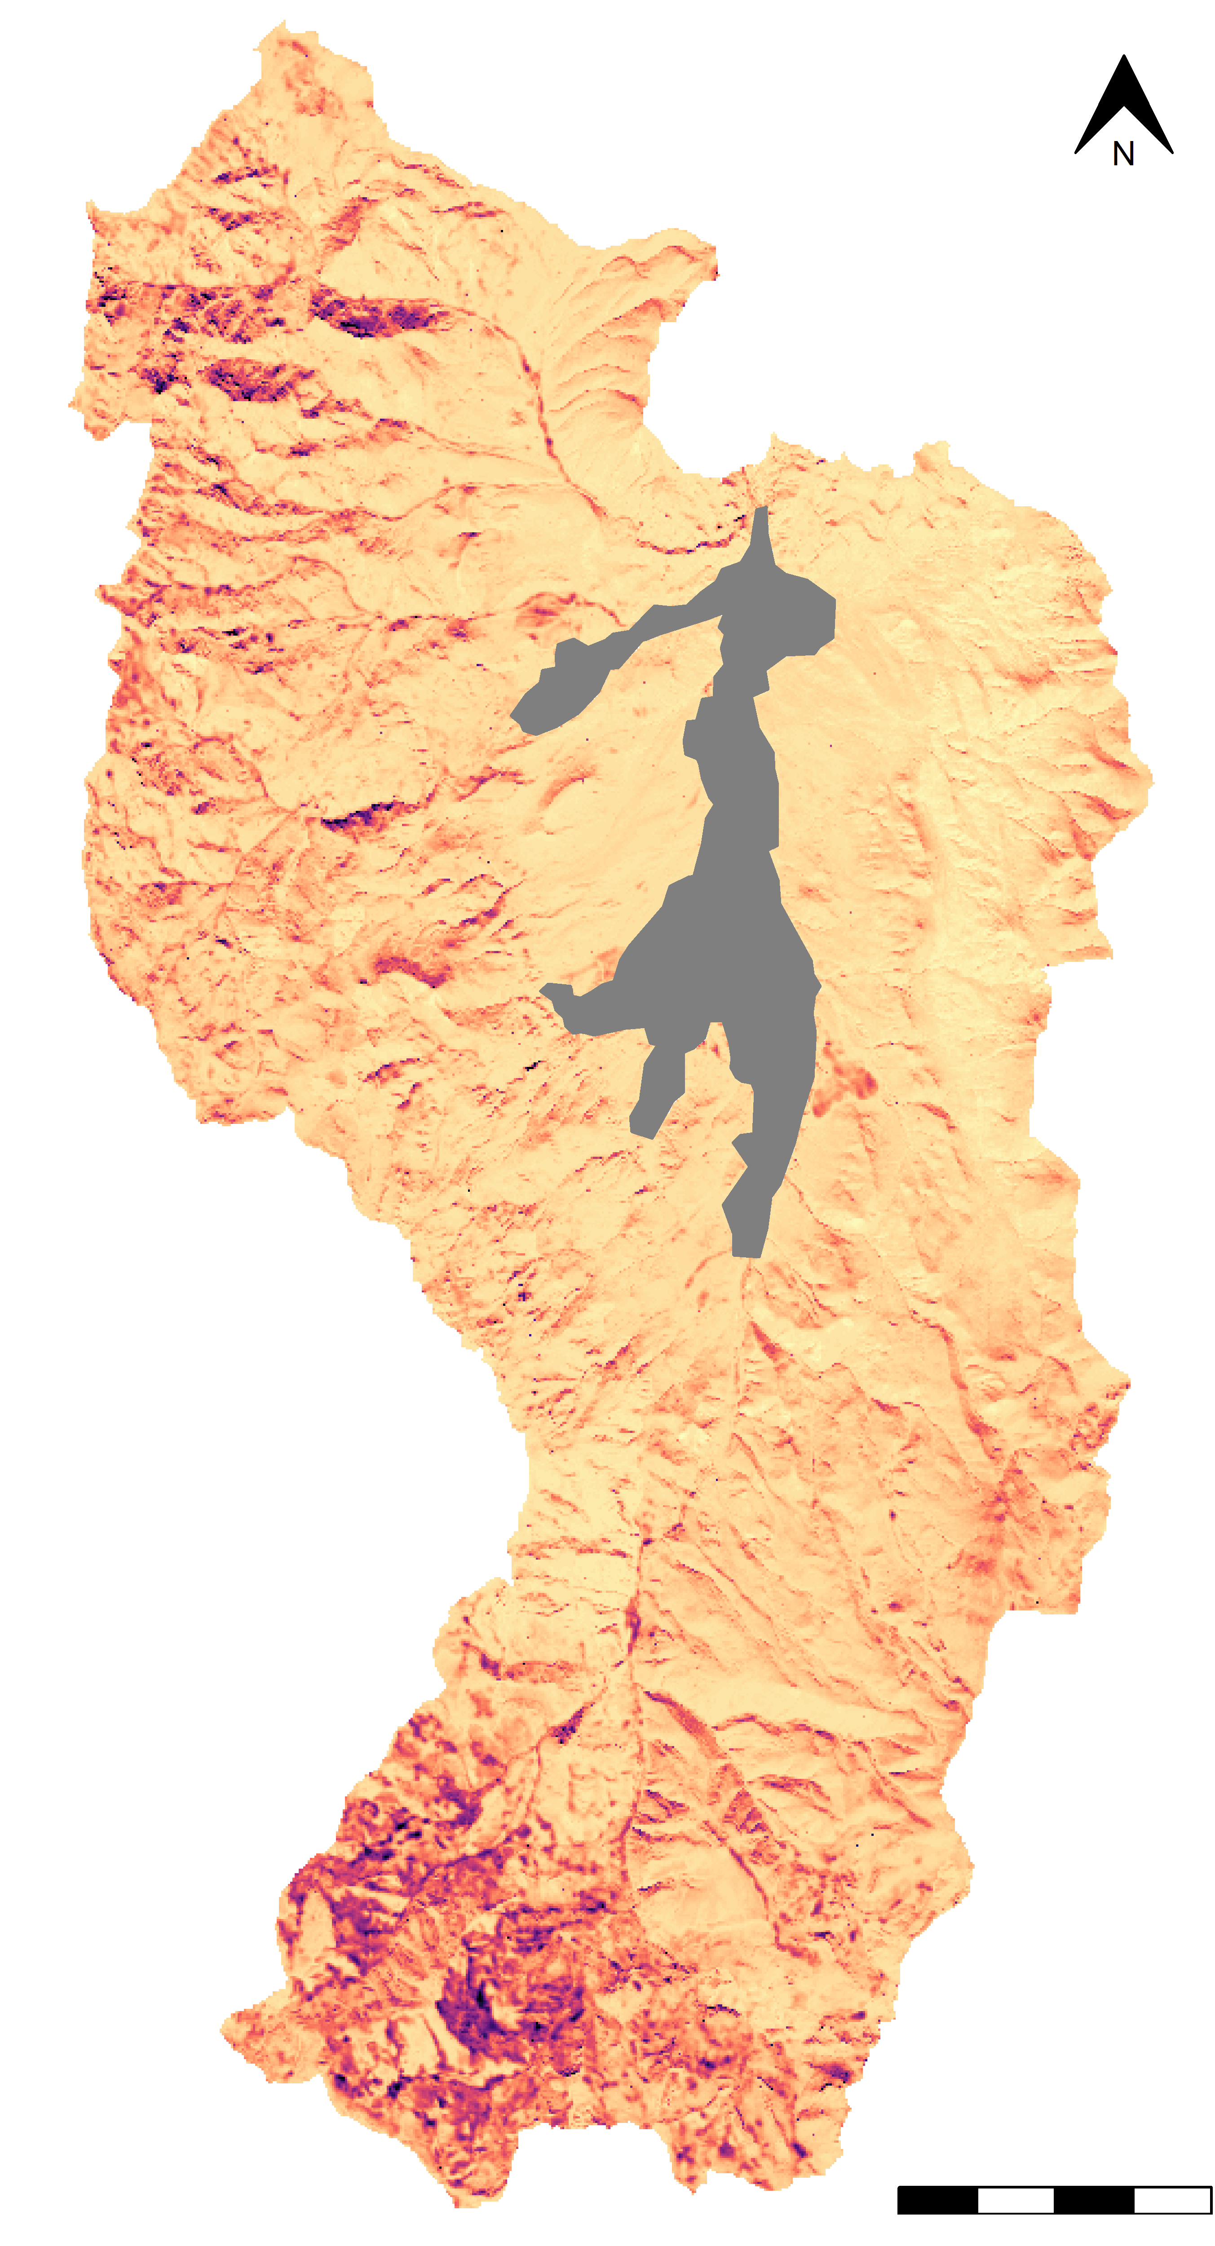
Gross Primary Productivity +10%
Soil Temperature +1 ̊C
MIMICS Projected Change in 0-30 cm SOC Stocks (kgC m⁻²)
0.9
0.6
0.3
0
-0.3
-0.6
MIMICS Ensemble Projected Change Standard Deviation (kgC m⁻²)
2.5
2.0
1.5
1.0
0.5
Agricultural Lands
4 km

